Slide 1
2013 UCI PERFORMANCE Engineering PROJECT
MARCH 11, 2013

Slide 2


MANAGEMENT TEAM
Jean Gaudreau
Orange County Department of Education,
Career and Tech Ed Program
Kathy Johnson
Vital Link
Michael McCarthy
Engineering Dept., UCI

Slide 3
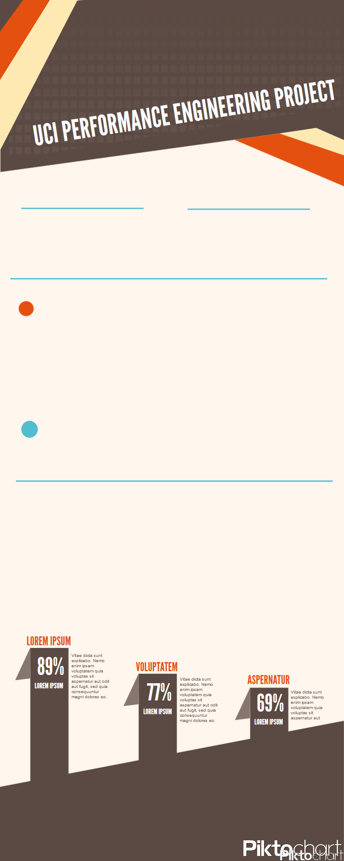
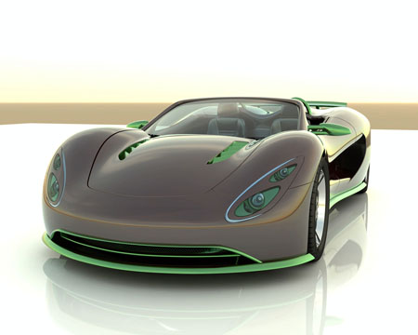
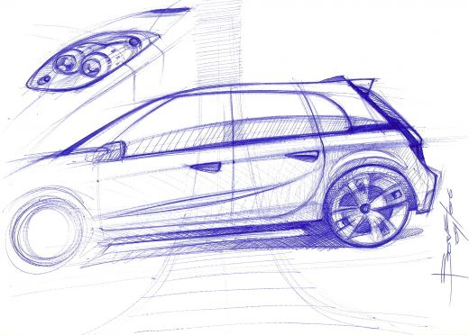
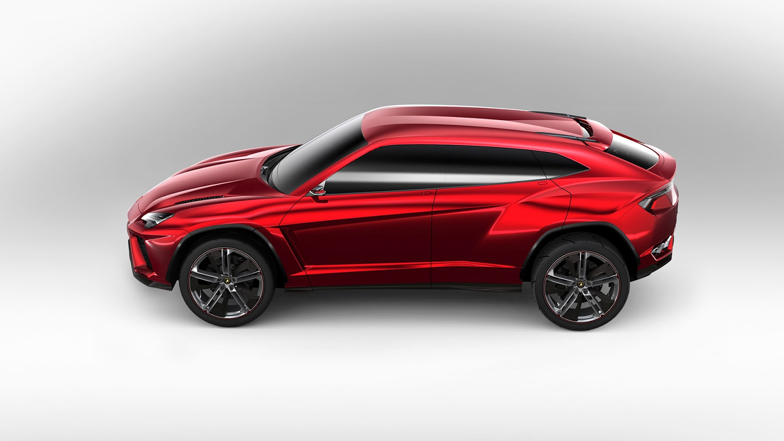
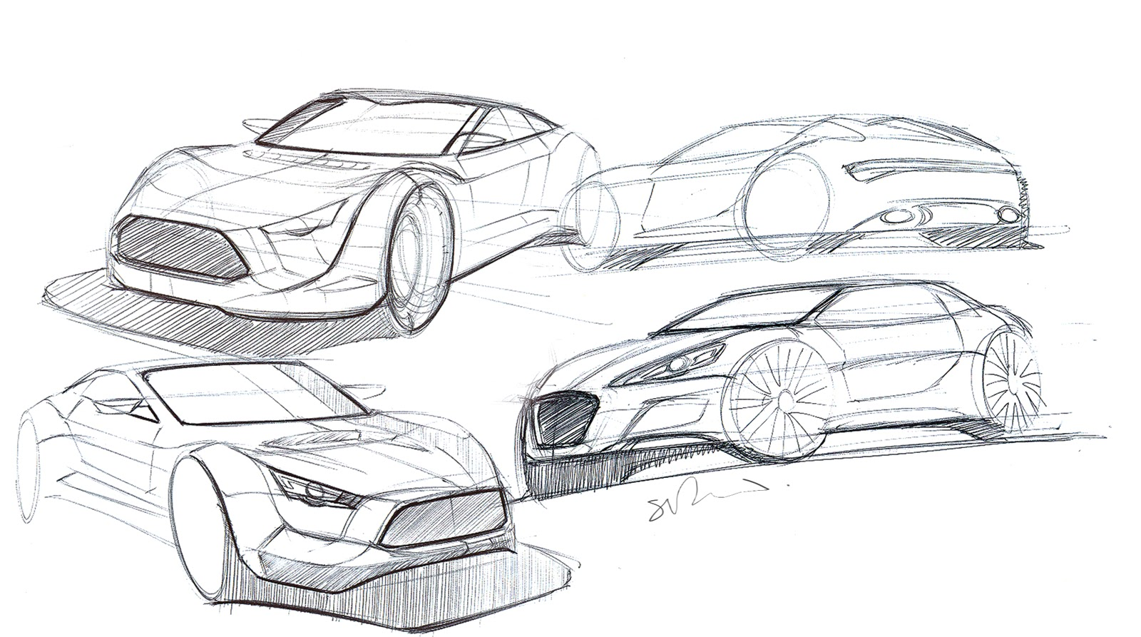
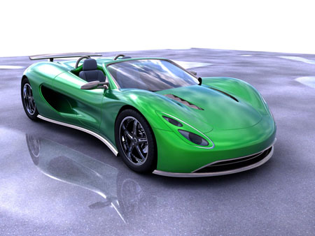
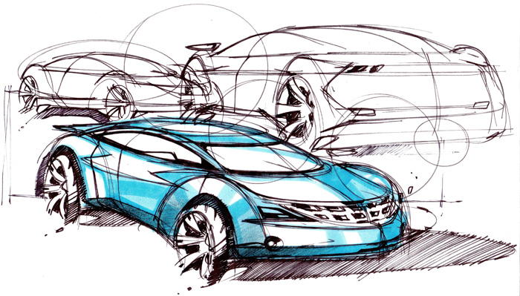
REAL-WORLD CHALLENGE:
PARTICIPATION:
High School
College and University Teams
4th year for project for College and University
2nd year for High School
Teams build an energy efficient vehicle
Open body and chassis designs
Open power plant designs
Use SolidWorks, 3D parts/model printing/welding/tooling
Prepare and present a Design Brief
Participate in a timed trail competition based on power management
Winner: Maximum distance in one hour using a dollar's worth of energy

Slide 4
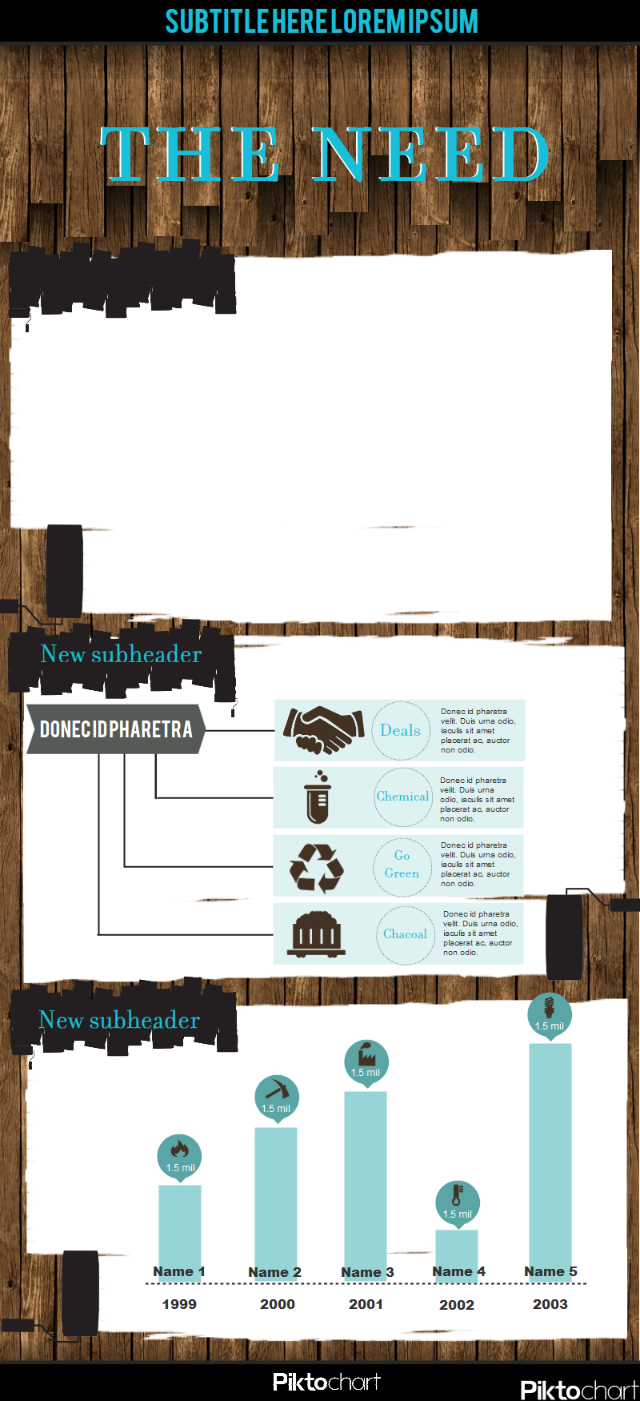
The need
1 out of every 19 graduating high school students comes from CA
Europe and China are out producing us 3 to 1 for engineers
HS students do not know what Engineering is about
Those students who do major in Engineering struggle with first year college programs
OC is a knowledge based economy with a strong presence in aeronautical, automotive and biomedical engineering
HS students do not know what Engineering is about
Those students who do major in Engineering struggle with first year college programs
OC is a knowledge based economy with a strong presence in aeronautical, automotive and biomedical engineering
Europe and China are out producing us 3 to 1 for engineers
1 out of every 19 graduating high school students comes from CA

Slide 5
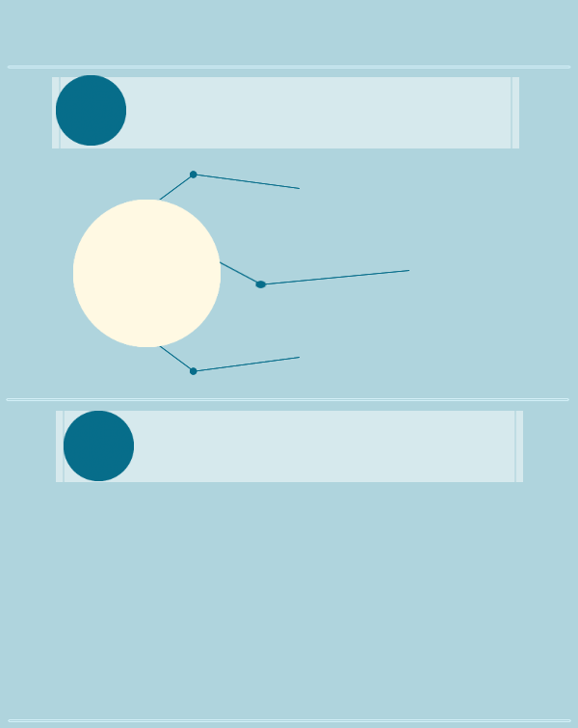
PERFORMANCE ENGINEERING
Current Status of Most Collegiate Engineering Programs:
    Theoretical, not hands on
High drop put rate
Not meeting employers needs
NEED TO:
    Provide a context for academics
    Solve real-world problems and challenges
    Provide transferable skills and more employable graduates
    Excite and show students their inherent skills

Slide 6
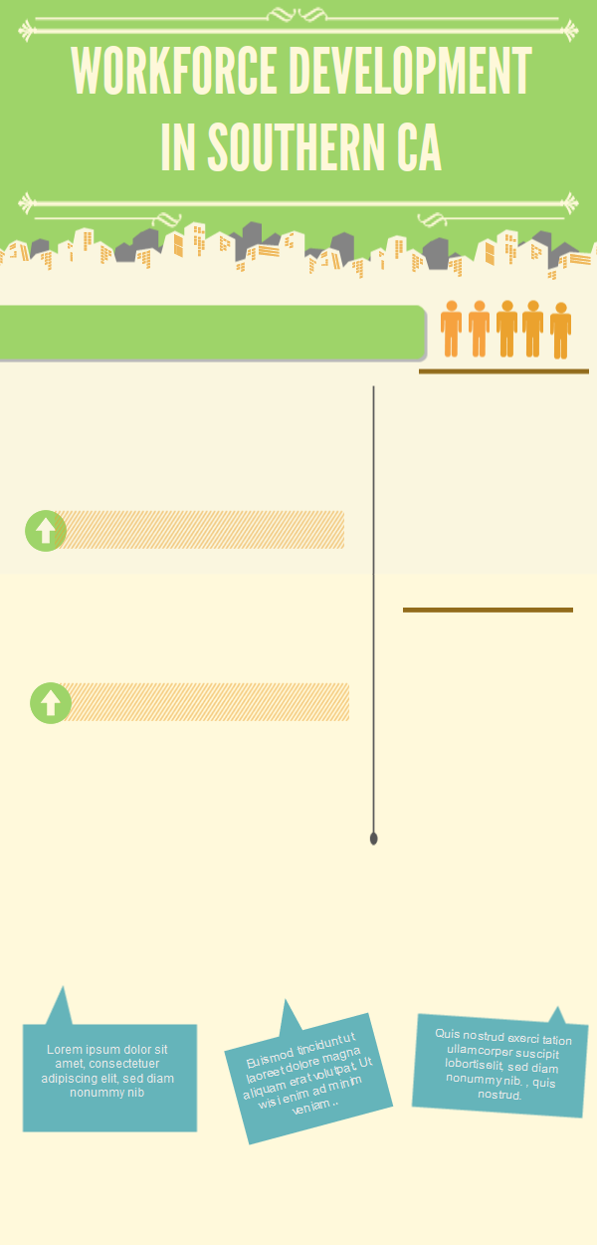
An employed engineer supports 10 other jobs and is worth $1M to the OC economy
Volunteer judging and mentoring provides a natural collaboration of education and industry
OC is a leader in advanced transportation, alternative fuels, and clean technology
Project based learning in STEM shows students a pathway to these high-wage, high-growth career
OC high school, college, and university project development teams can provide a laboratory for this technology

Slide 7
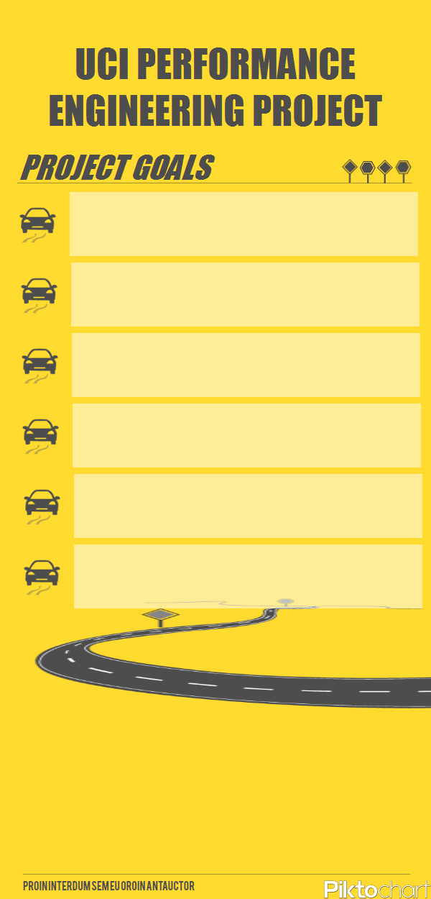
Enhance STEM education through project based learning
Prepare students with real-world skills
Engage students in academics so they are on a pathway to college
Give them a pathway and role models for high-wage occupations
Fill Orange County’s work force needs at all levels
Students learn applied math, science, engineering,
technology, budgeting, marketing, managerial,
and communication skills
Have a lot of fun along the way!

Slide 8
PERFORMANCE ENGINEERING
Solutions oriented: create, test, improve performance, re-test
Roles, skills, activities, and deliverables applied at every phase of development
Technology is not stagnant and major technological shifts will happen
Students learn some backbone technologies and figure out ways to adapt/improve them
Brainstorm, design, build, test……do it all over again and again
LEARN UNDER “GAME DAY” CONDITIONS

Slide 9

PERFORMANCE ENGINEERING
PROVIDES:
Social learning
Individualized learning
Multi-disciplinary academic learning
Creative and innovative experiences
Connections and Mentorships– students/industry/post -secondary
Engagement at a broad and deep level
Strong partnerships to bolster the student experience

Slide 10
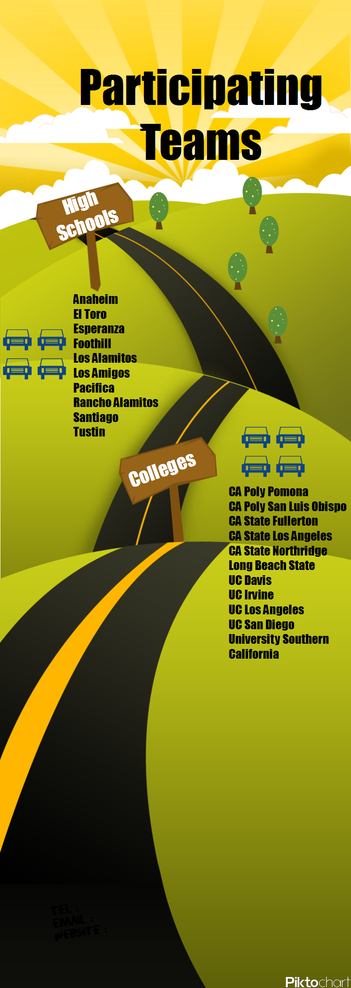
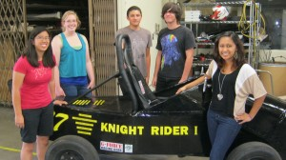
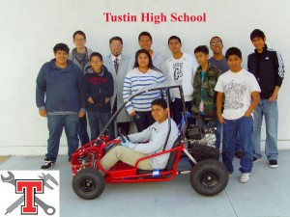
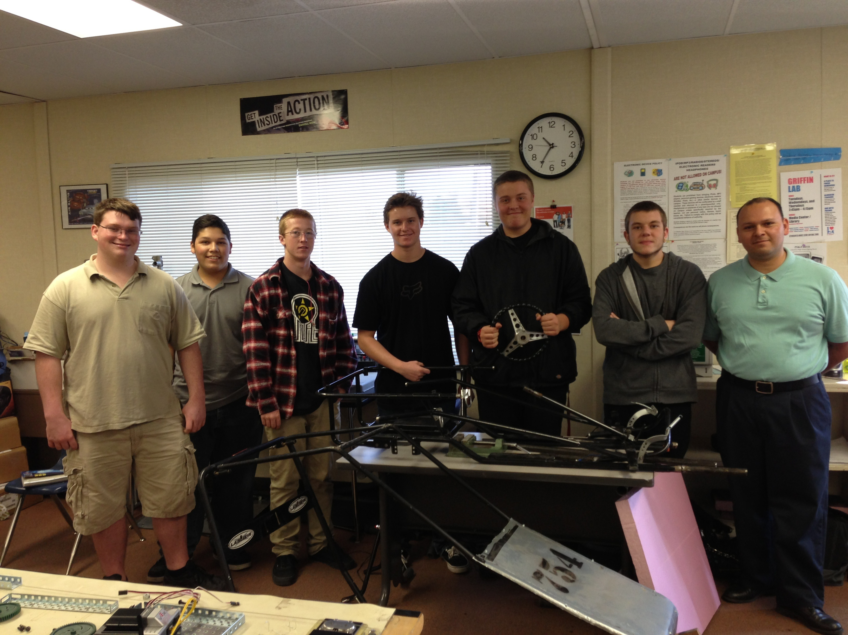
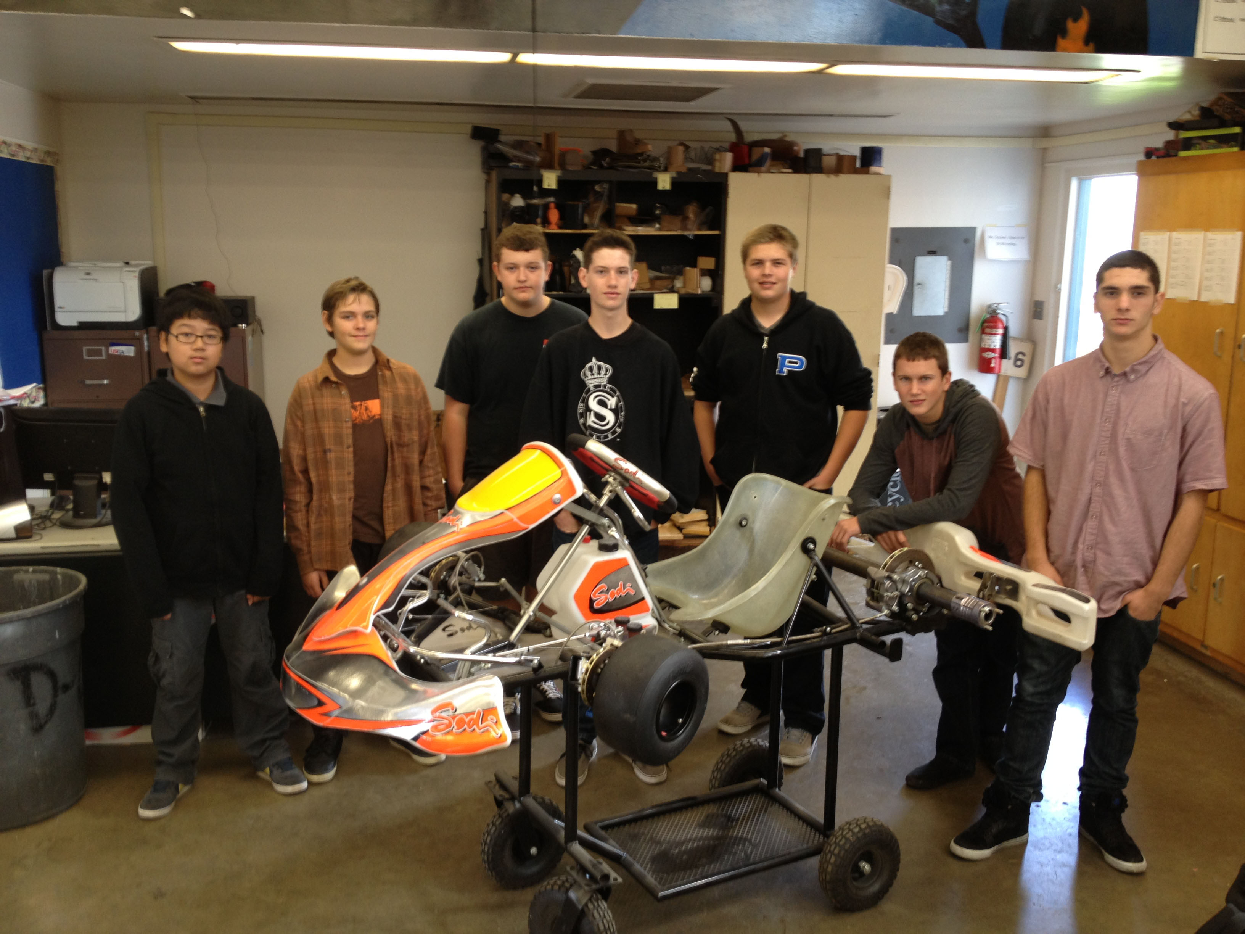
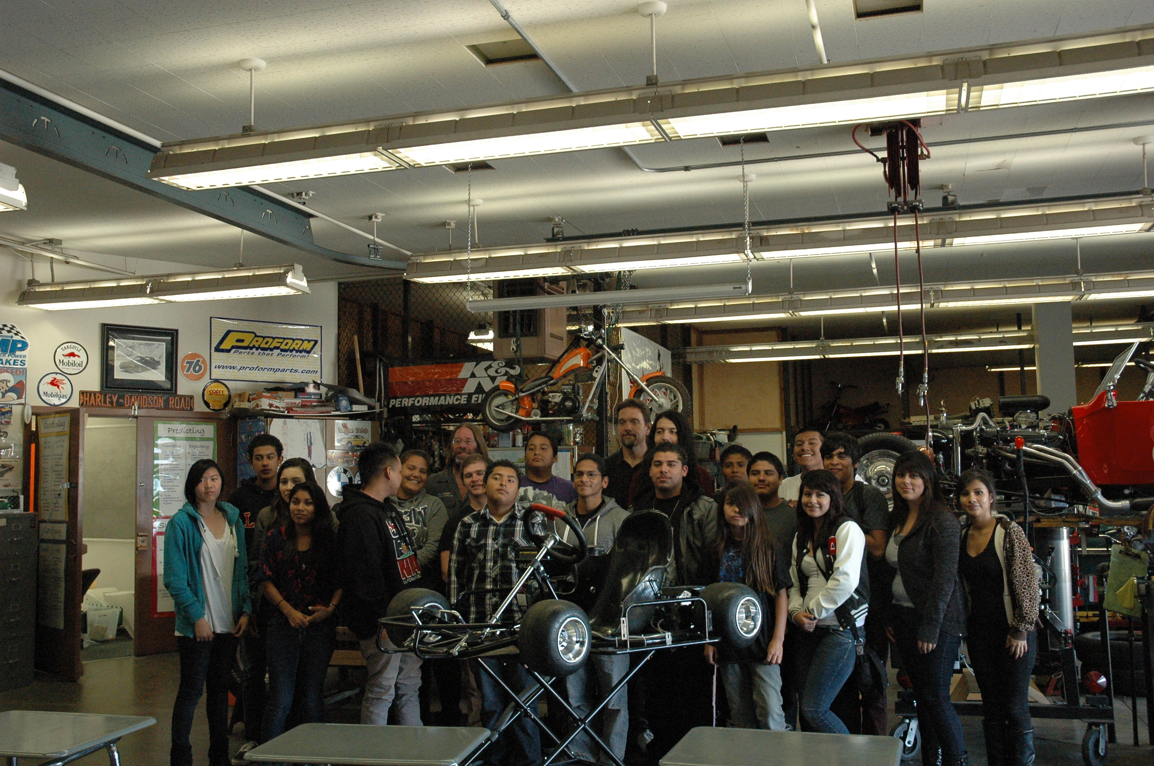
PARTICIPATING TEAMS
COLLEGES

Slide 11

2011-12 RACE VIDEO
Time Trial

Slide 12
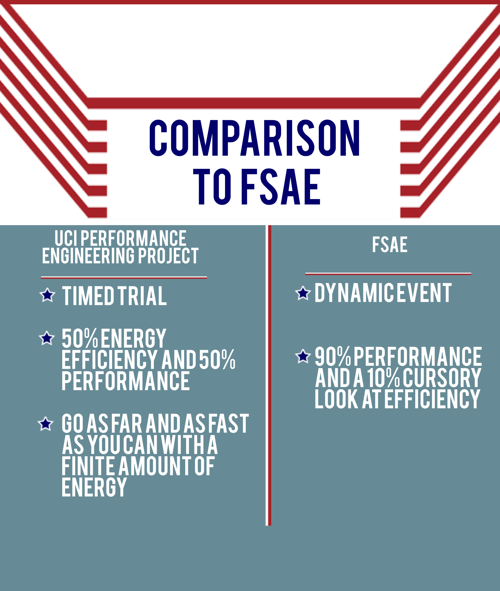
COMPARISON TO FSAE
UCI PERFORMANCE ENGINEERING PROJECT
FSAE
Timed trial
50% energy efficiency and 50% performance
Go as far and as fast as you can with a finite amount of energy
Dynamic event
90% performance and a 10% cursory look at efficiency

Slide 13
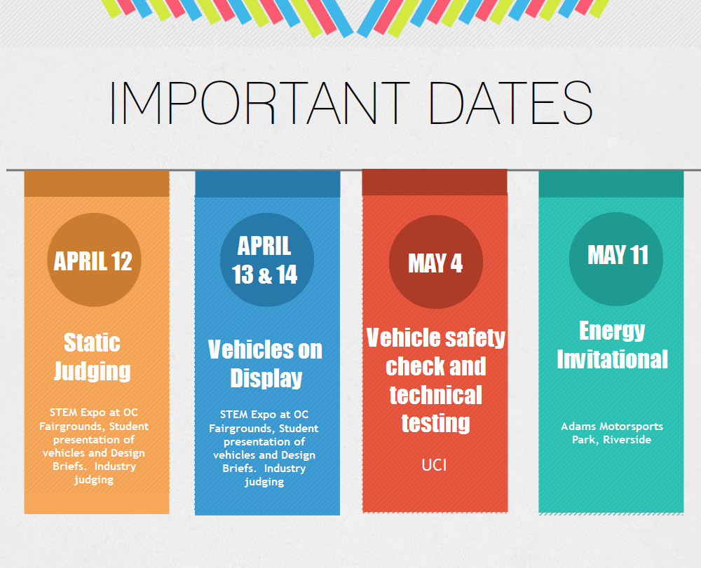

Slide 14
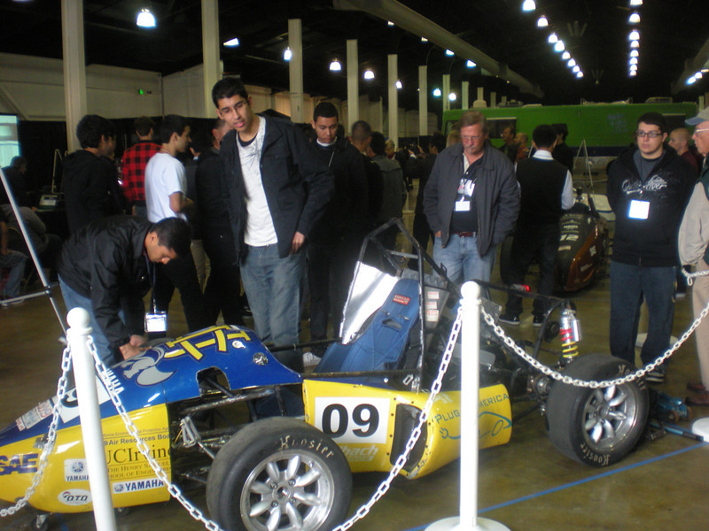
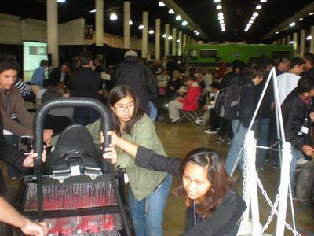
STEM EXPO– APRIL 2013
Held at OC Fairgrounds and Event Center
Open to the public
Vehicles on display for 3 days
Static judging and student presentations of Design Briefs
Judged by industry volunteers using a rubric
Judging based on design, safety, technical creativity, written Design Brief, oral & visual presentation

Slide 15
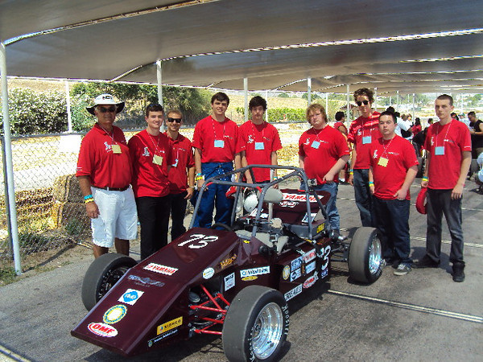
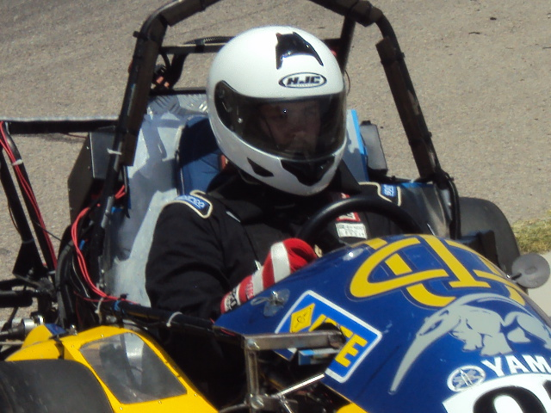
UCI ENERGY INVITATIONAL – MAY 2013
All day event
Open to the public
Timed trial
Elimination rounds in morning
Championship rounds in afternoon

Slide 16
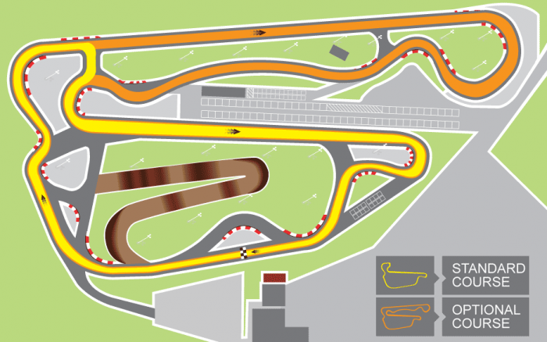
ADAMS MOTORSPORTS PARK

Slide 17
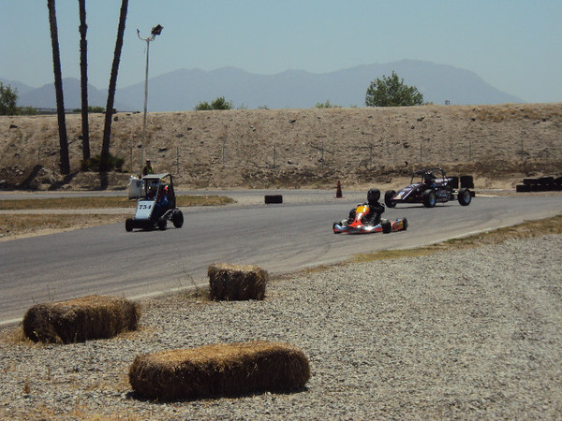
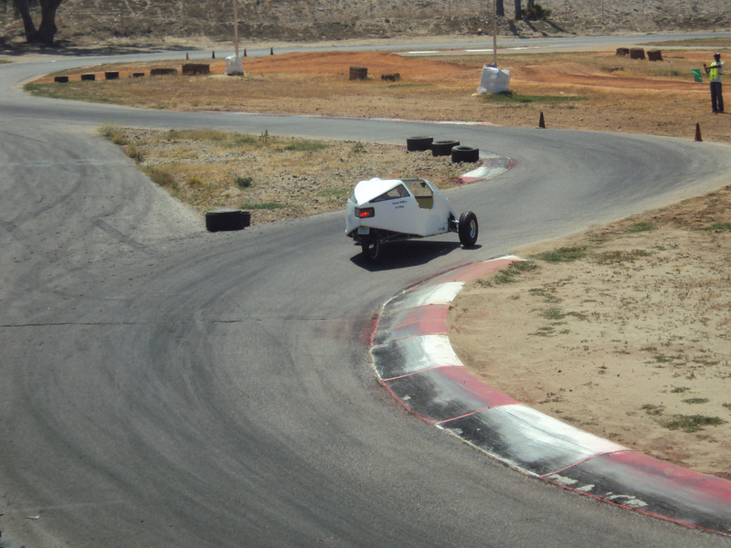
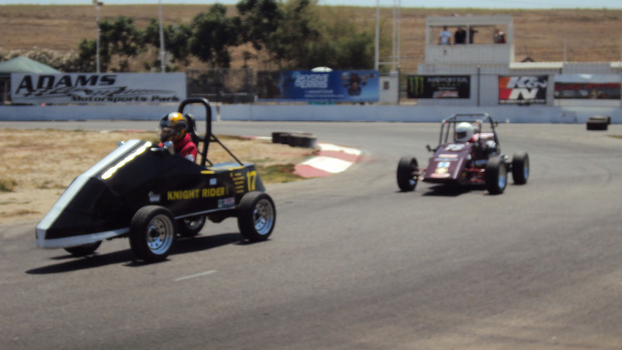
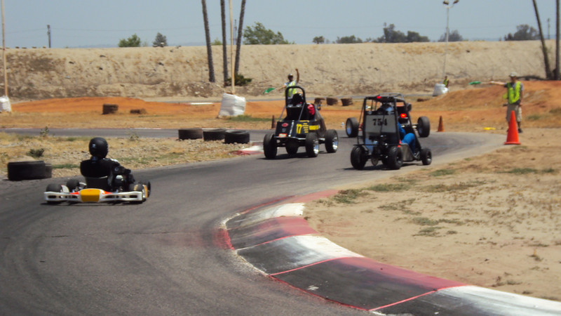

Slide 18
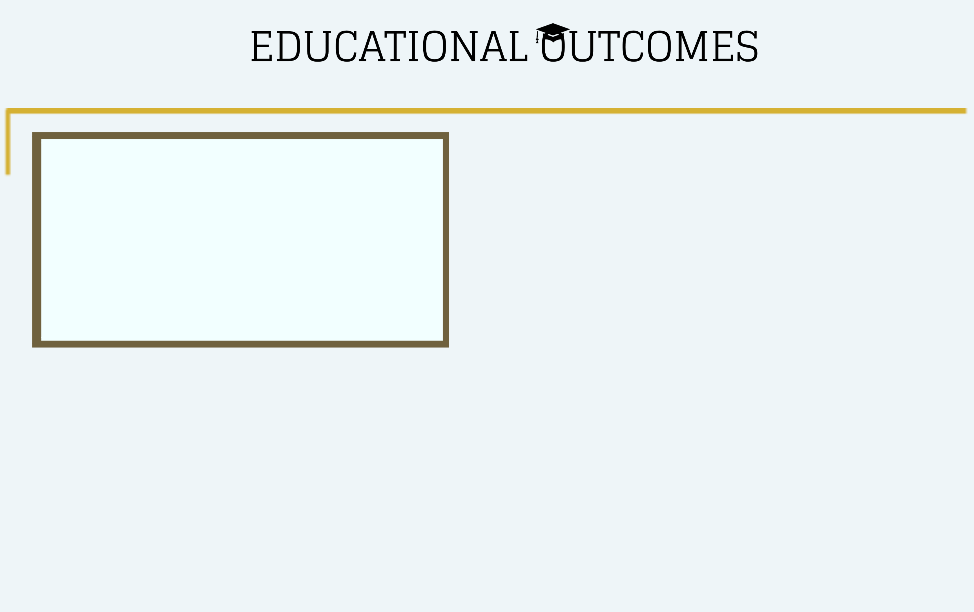
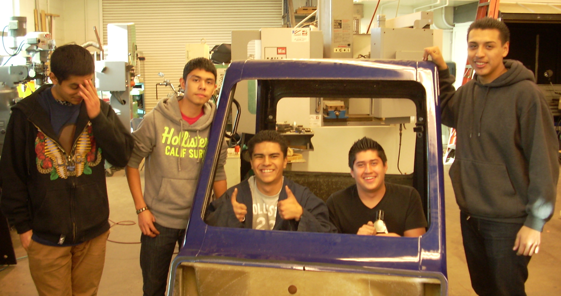
  Technical reading and writing
  Systems Testing and Analysis
  STEAM Integration and Application
  3D Printing
  CAD – Solidworks/Inventor
  Welding
  Electrical engineering
  Mechanical engineering
  Energy sources and energy management
  Structures and materials
  Fluid mechanics
  Business Management
  Design Brief – “We do not learn from experience, we learn from reflecting on experience.”
  John Dewey

Slide 19
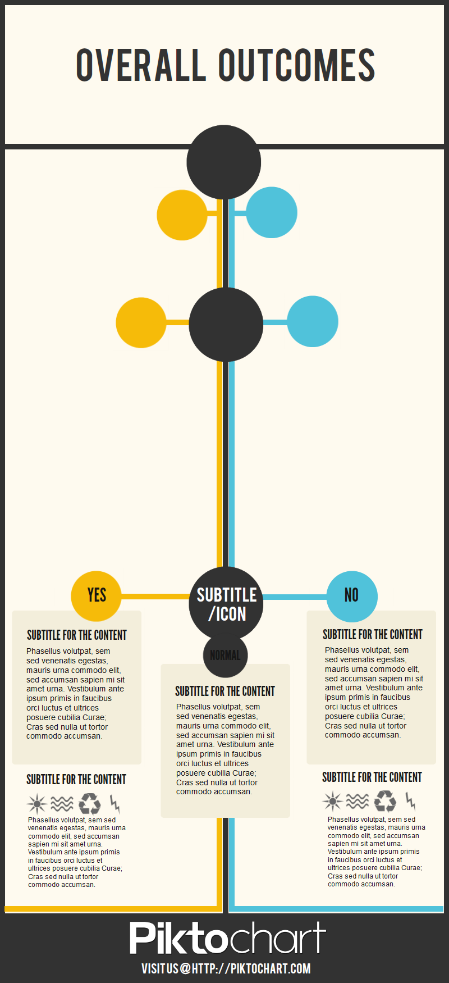
Understanding of Engineering and STEM careers and educational opportunities
Soft Skills – teamwork, reliability, leadership, time management
Increased enrollment in engineering related courses
Communication and Presentation Skills

Slide 20

INDUSTRY
ADVISORY
COUNCIL
MEMBERS:
PURPOSE:
Automotive Manufacturing Companies
Auto Related Affiliate Companies
College/University Representatives
Project Management Team
Guidance and Strategic Planning
Networking
Funding

Slide 21








sponsors and/or members of the project’s Industry Advisory Council:

Slide 22

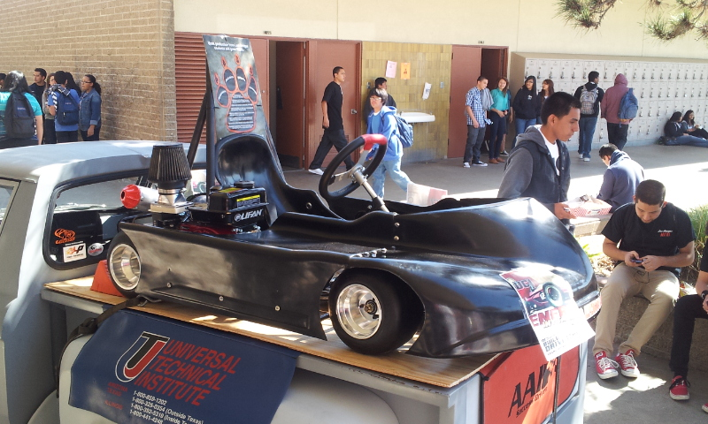
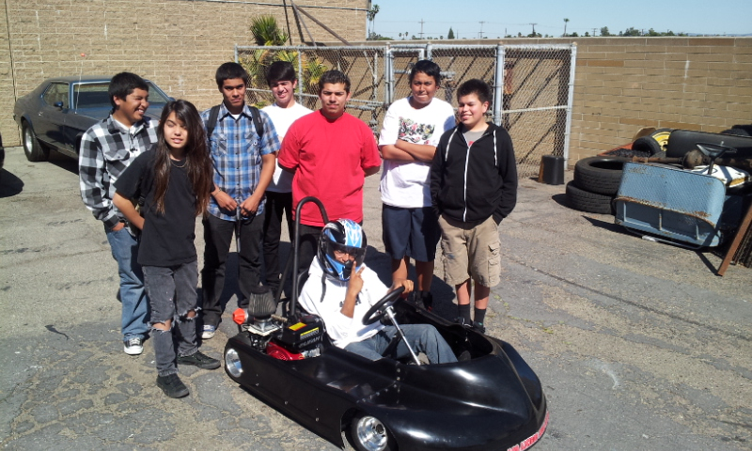
PROJECT COSTS
Purchase a kit
Build from ground up
Modify an existing vehicle
Safety suits, shoes, neck guards, helmets, gloves
5 Point Safety Harnesses and Arm Restraints
Insurance
Event and Meeting Costs – racetrack rental, equipment, food, etc.
Subs, buses, vehicle transport
Vehicle:

Slide 23
FUNDING
Automotive Manufacturing Companies
Professional Associations
Auto Related Affiliate Companies (parts and funding)
Energy Companies
Orange County Department of Education
SB70 Funding
Perkins Funding
ACT II Grant Funding

Slide 24
PROJECT OBSTACLES
Multiple School Districts
Waivers
Gathering teachers offsite
UCI partner – time and travel
Overall costs and funding
Equipment and supply needs
Judges, mentors, advisory board
Rules: technical and safety
Need a space to innovate and create
Build curriculum around this experience

Slide 25



Slide 26
THE STUDENTS ARE A LITTLE DIFFERENT FROM OUR GENERATION!

Slide 27


Slide 28
Contact information
Jean Gaudreau
jgaudreau@ocde.us
Kathy Johnson
Kathy @vitallinkoc.org

